Slide 1

Capstone Project Report On
“TRAVEL APPROVAL APP”
BY:
Name: BALARAM PHIRADULA
Batch WIP-SF-13
LMS Id: MGSA_527

Slide 2

CONTENTS
INTRODUCTION TO SALESFORCE
INTRODUCTION OF TRAVEL APPROVAL APP
MODULE 1
MODULE 2
MODULE 3
CONCLUSION

Slide 3


INTRODUCTION TO SALESFORCE
What is salesforce?
Why do we use salesforce?
What does Salesforce do?
What are the benefits of Salesforce ?
What is CRM
What is Cloud Computing

Slide 4


INTRODUCTION OF TRAVEL APPROVAL APP
The travel approval project in Salesforce is a system designed
to automate and streamline the process of requesting and
approving travel expenses for employees. The project
involves several components, including a custom object to
track travel requests, a custom approval process, and various integrations with external systems.
Overall, the travel approval project in Salesforce provides a streamlined and efficient way for employees to request and manage travel expenses, while also providing managers with the tools they need to ensure that all expenses are approved and accounted for.

Slide 5
MODULE 1
This project module focuses on the non-coding approach to modifying
the user interface, as you customize an app that tracks company travel.
Create Custom
App, Objects, Fields & Relationships, and how you customize the App using
declarative tools.
Module Take Away

Slide 6
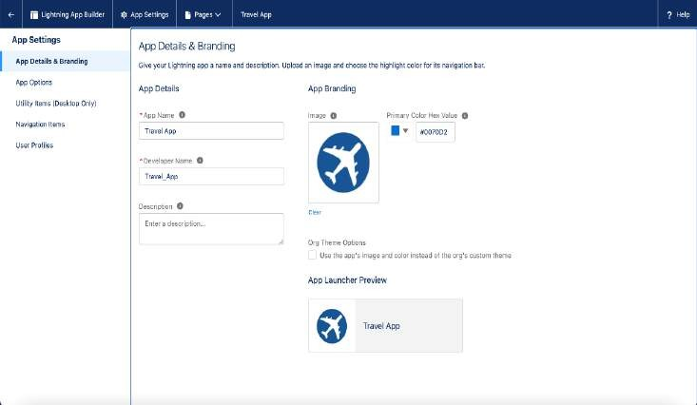
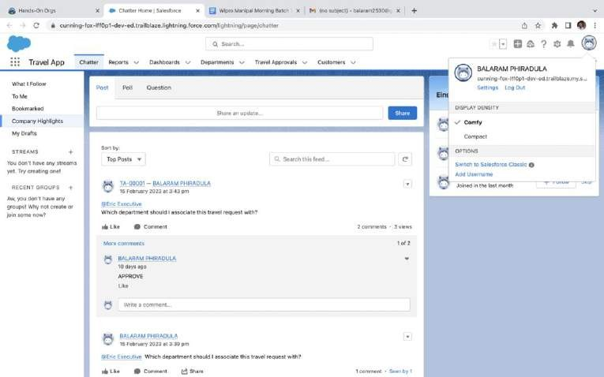
Creating Lightning App: TRAVEL APP

Slide 7
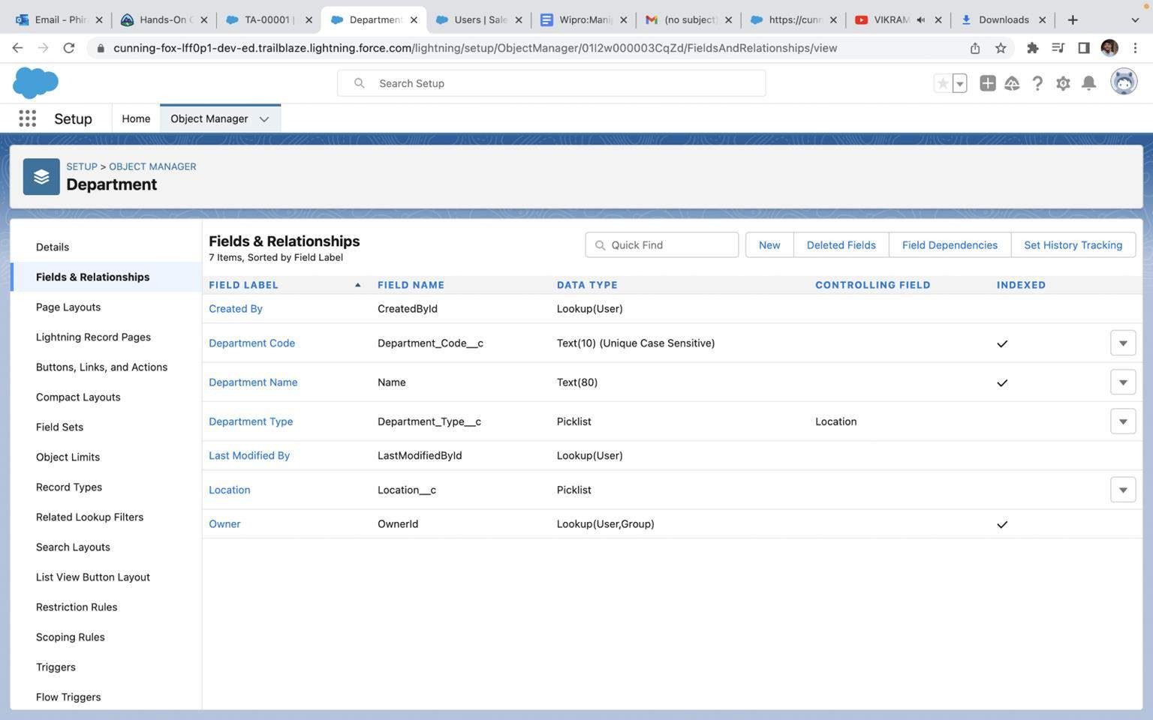
Custom object Department and Creating custom fields in Department Object

Slide 8
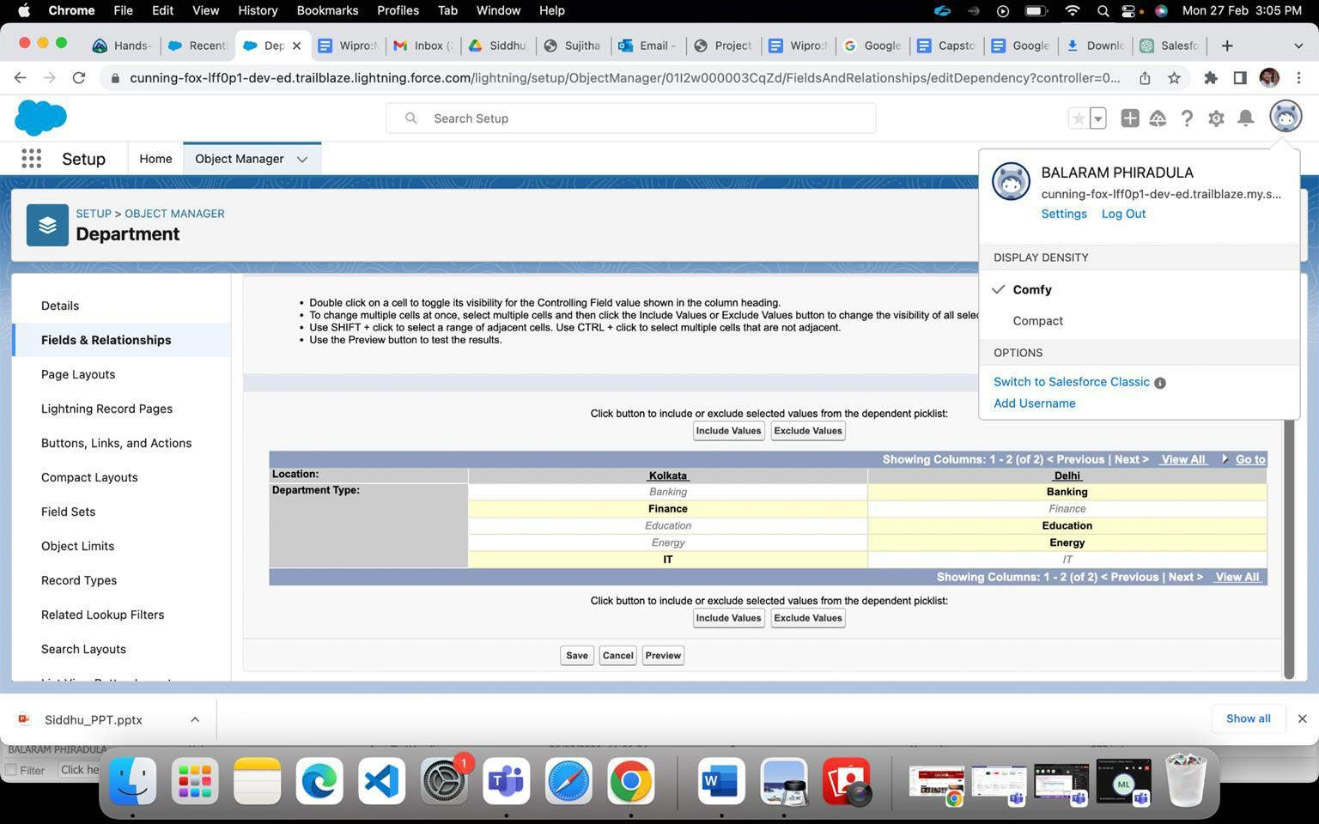
Field Dependency in Department

Slide 9
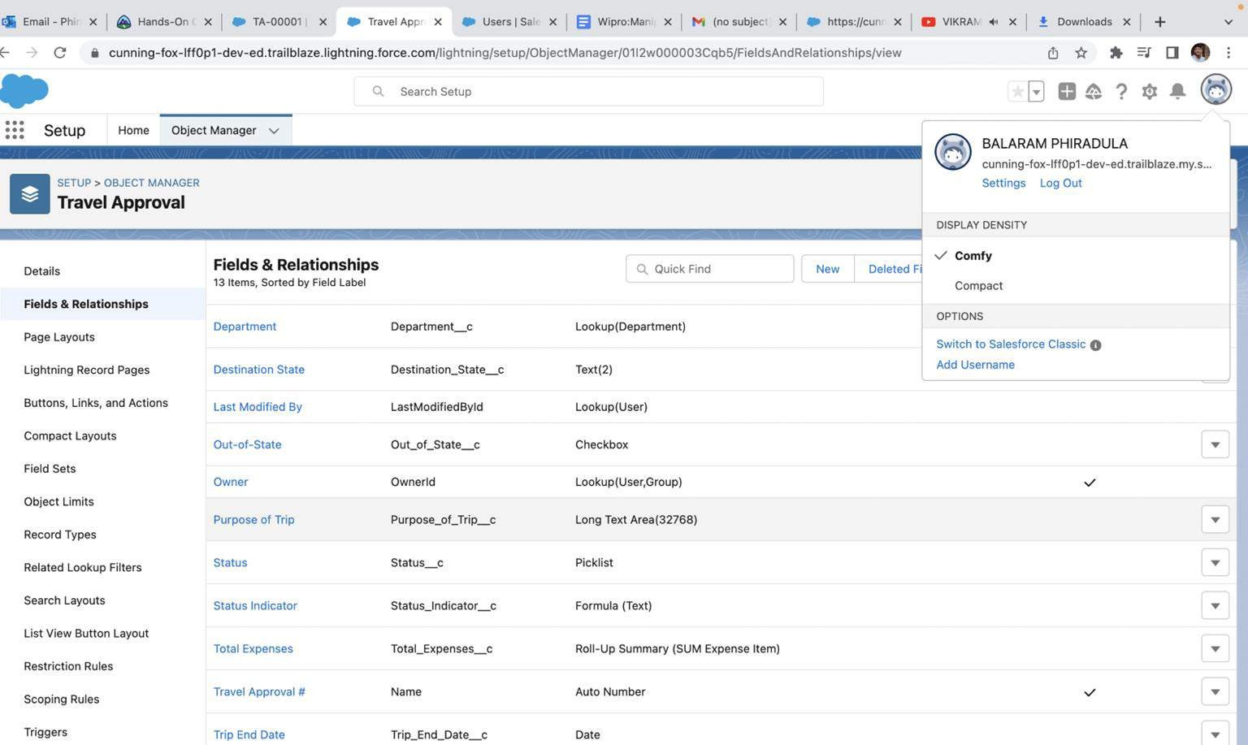
Creating Custom Object Travel Approval and Custom Fields in that Object

Slide 10
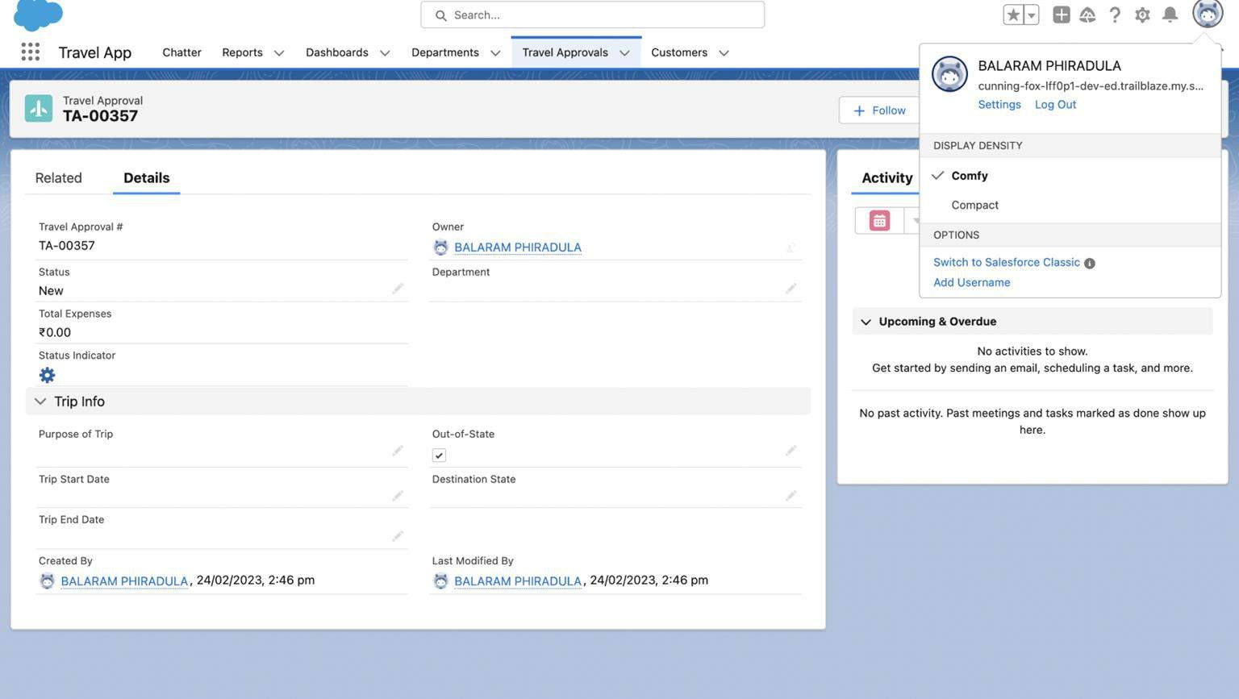
After creating Travel Approval object with fields, it looks as shown below

Slide 11
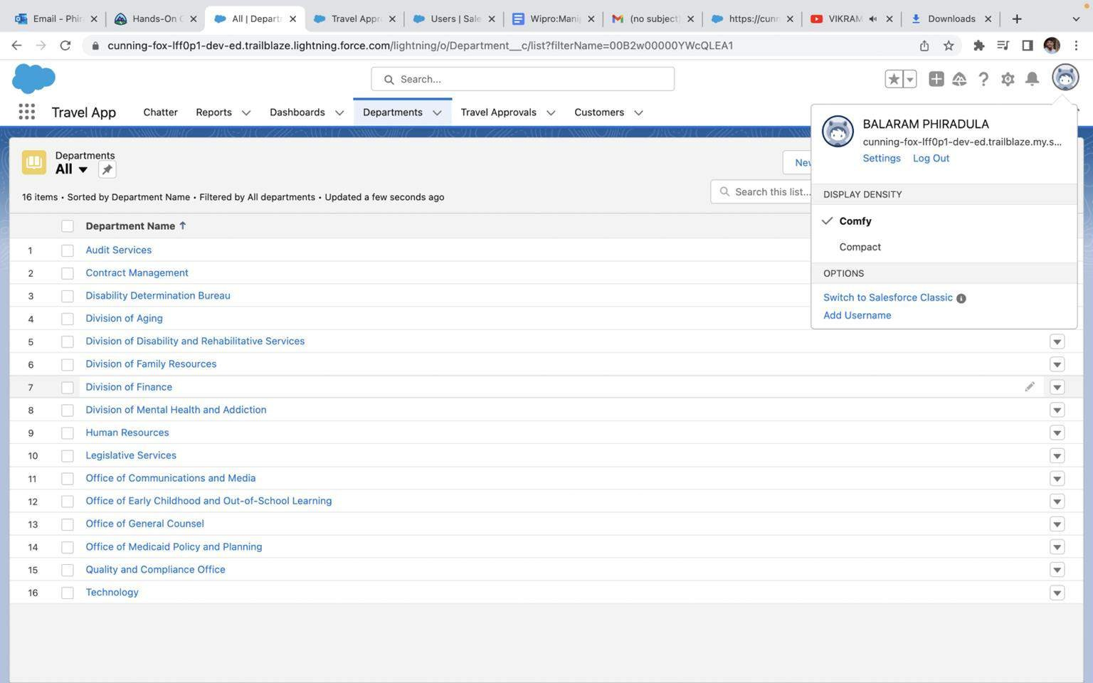
Importing Department records using data import wizard and imported record data status can viewed below

Slide 12
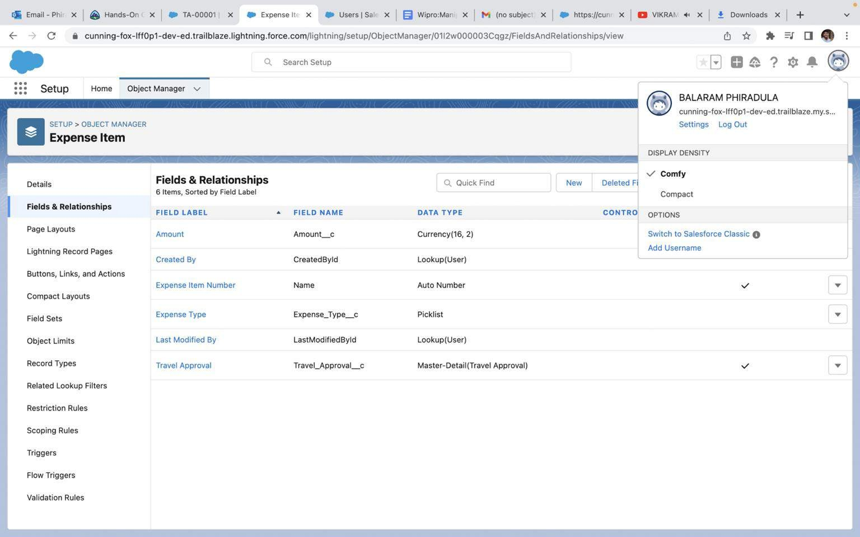
Creating Expense Item custom object and Custom fields in Expense Item object

Slide 13
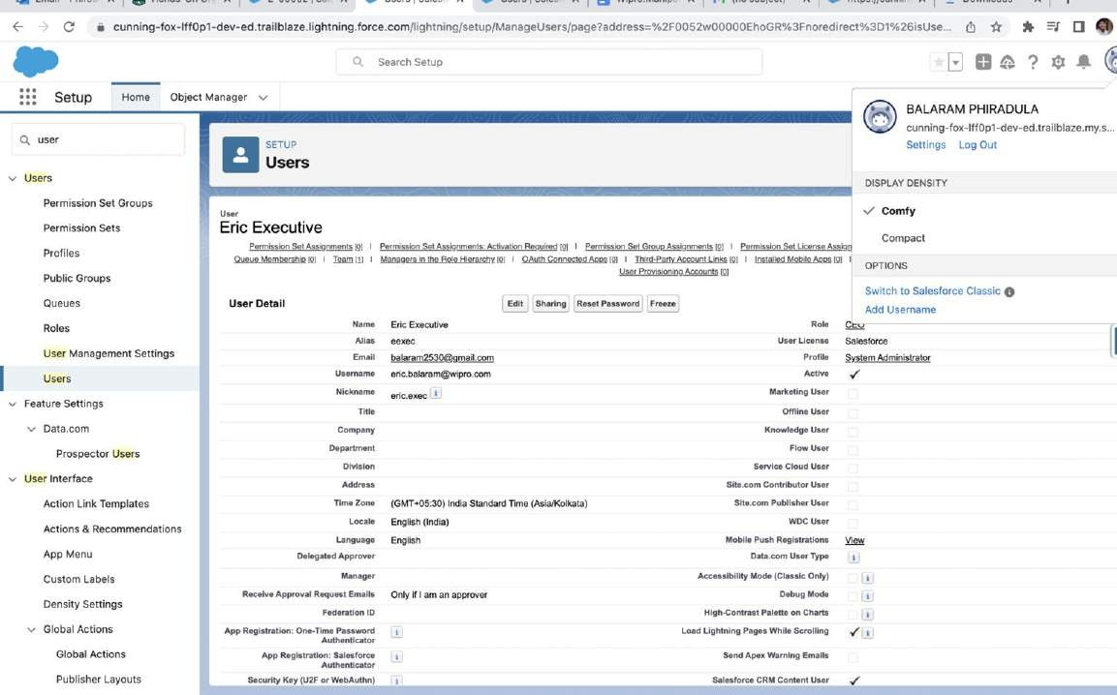
Creating User with system admin license

Slide 14
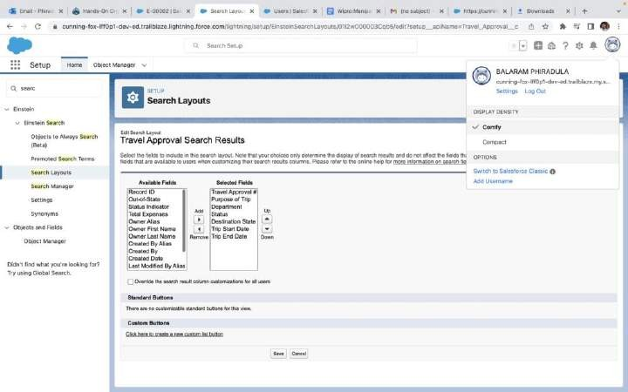
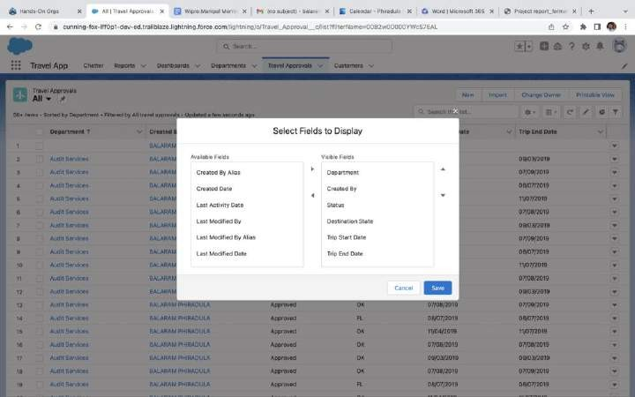
Customize the Travel Approval Default search layout
Select fields to display in the Travel
Approval “All” List view

Slide 15
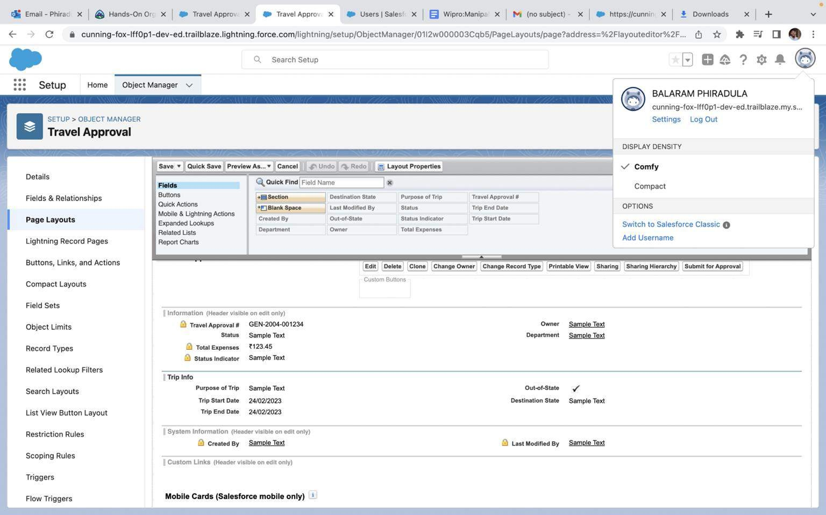
Customizing page layout

Slide 16
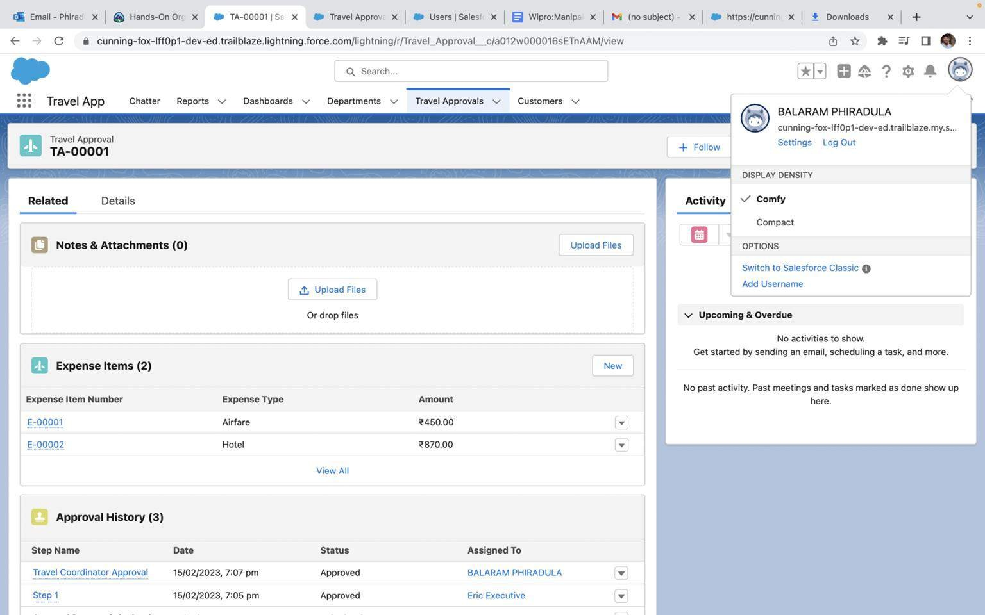
Test the app:

Slide 17
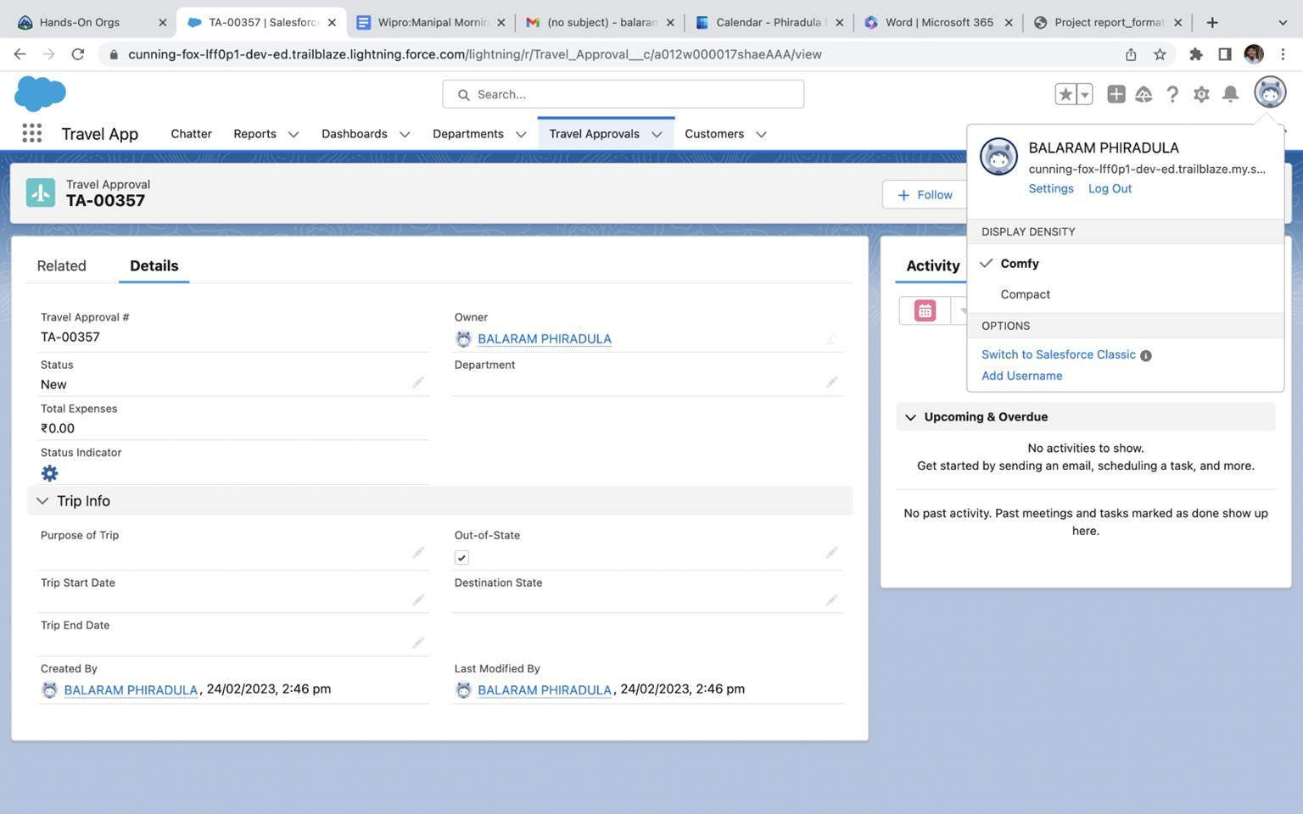

Slide 18

MODULE 2
This project module focuses on the Automation and Analytics Tools
to enhance your custom App development.
Define Business logic using Validation rules, Roll-up summary fields, Formulas, Flows & how you track Travel Approvals using Reports and Dashboards

Slide 19
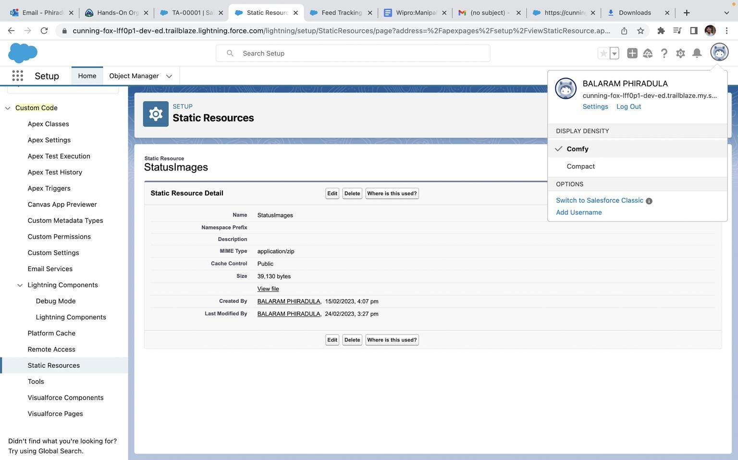
Creating Formula Fields
Static Resource with name StatusImages

Slide 20
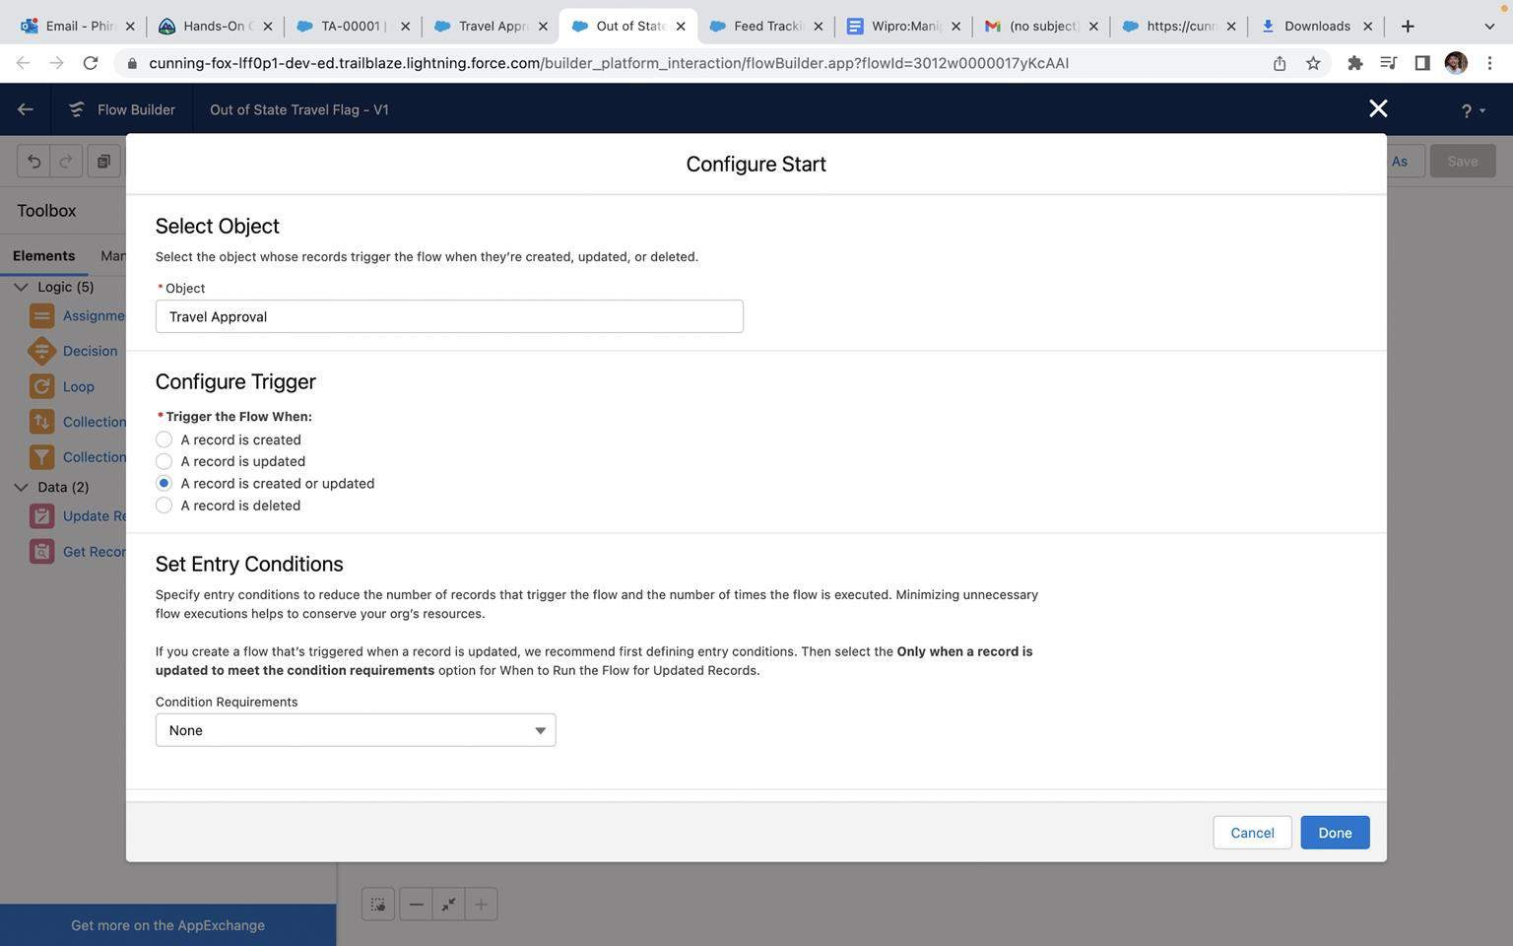
Create a Record – Triggered Flow

Slide 21
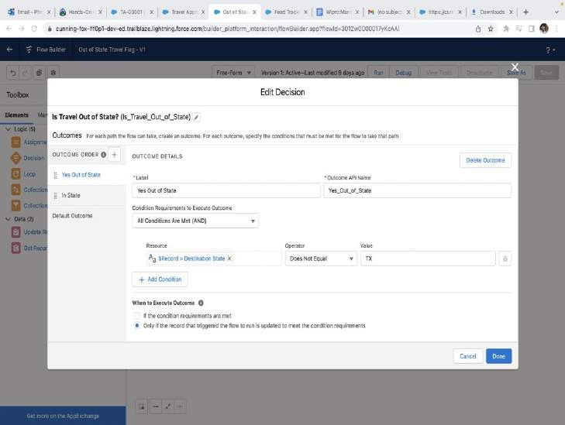
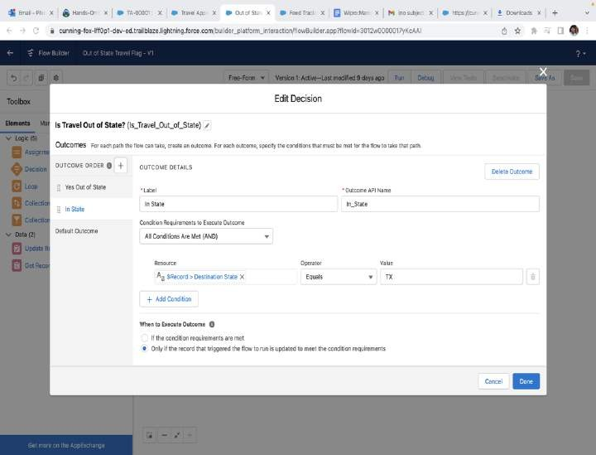
And add Decision element to flow

Slide 22
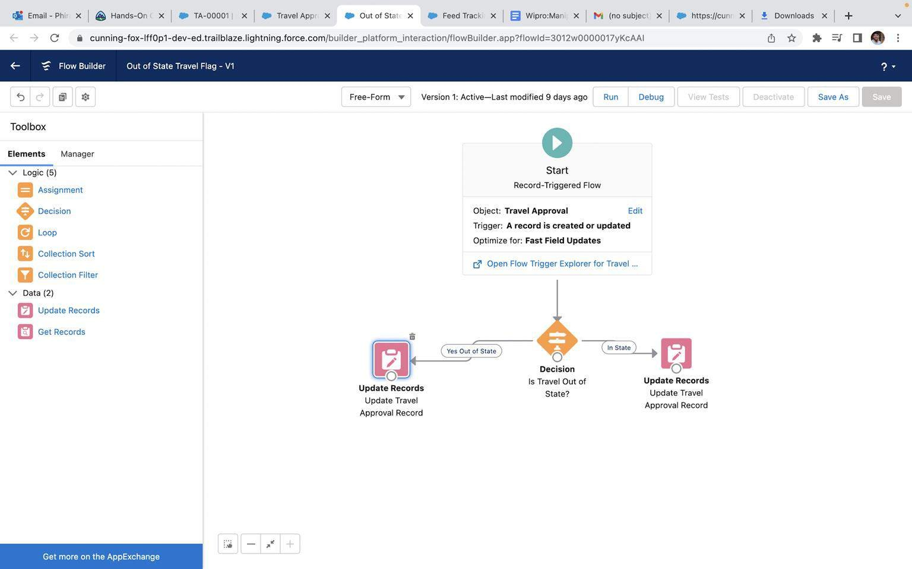
Finally, the flow looks as shown, save and activate

Slide 23
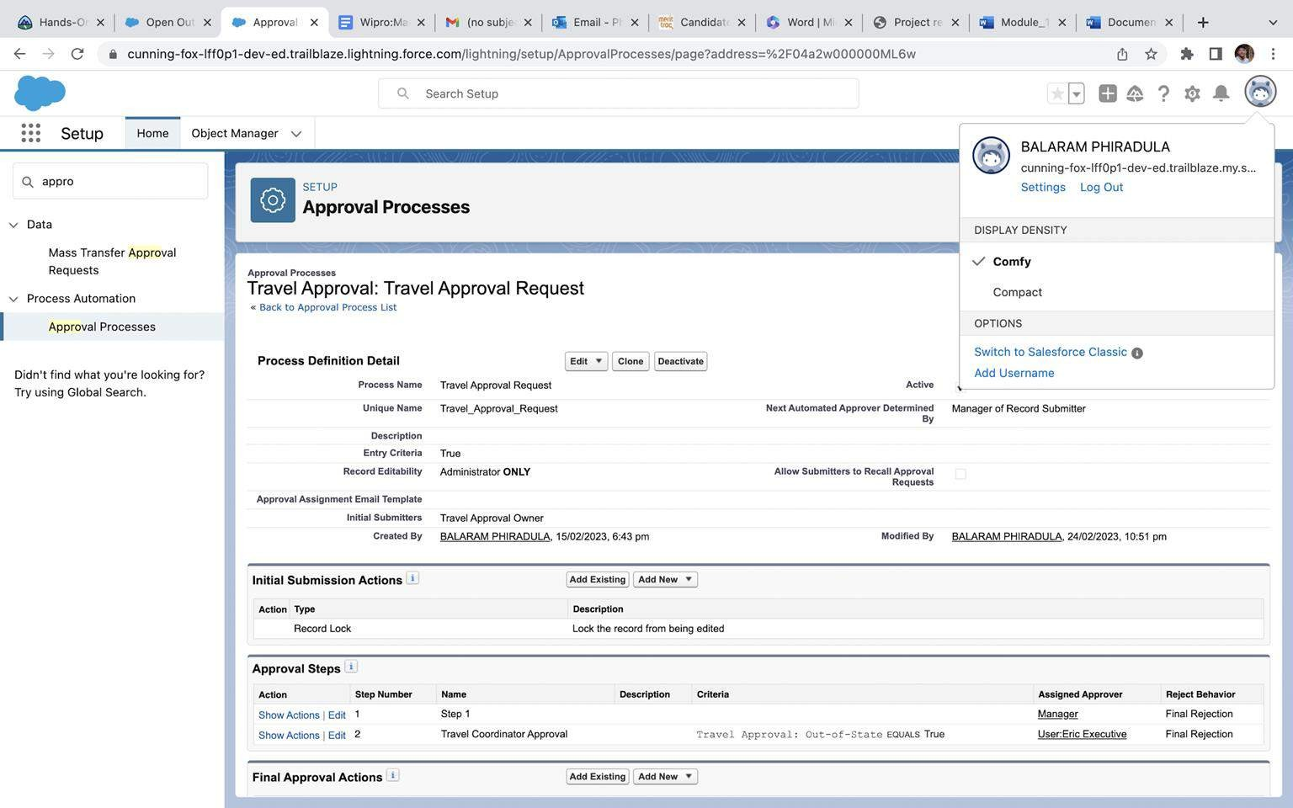
Creating an Approval Process to send travel approvals to manager or travel coordinator

Slide 24
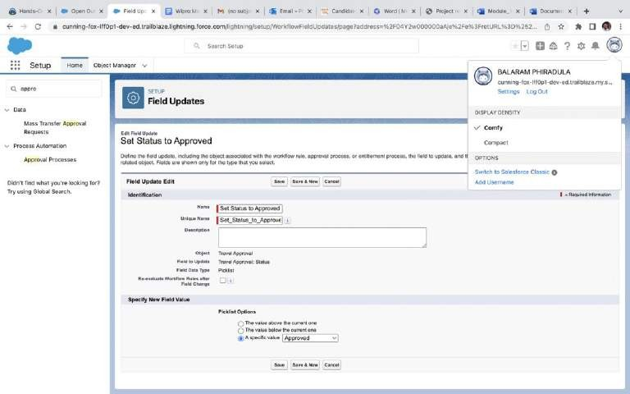
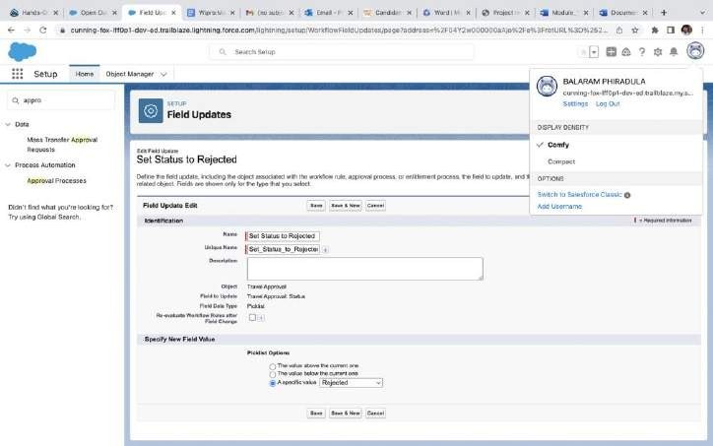
Final Approval Action:
Final Rejection Action:

Slide 25
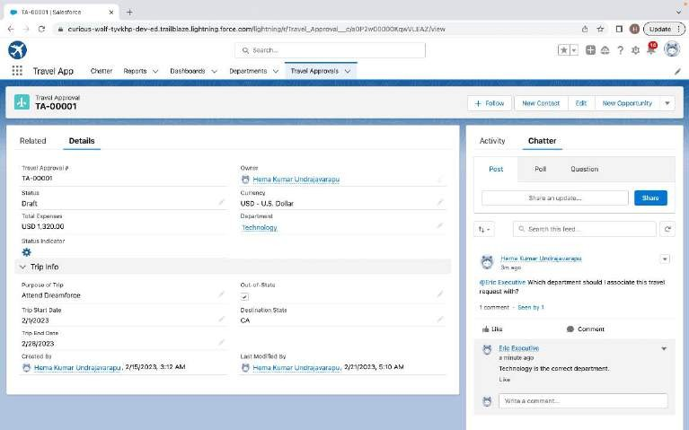
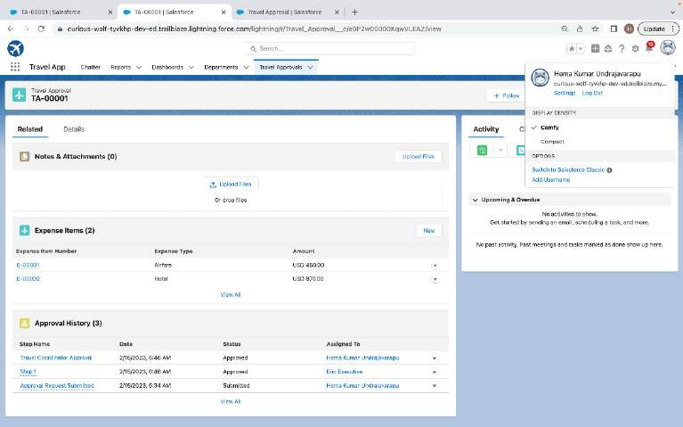
Testing the approval process Status is pending here, Next submit for approval
Login as Eric to give Approval Can Approve or Reject

Slide 26
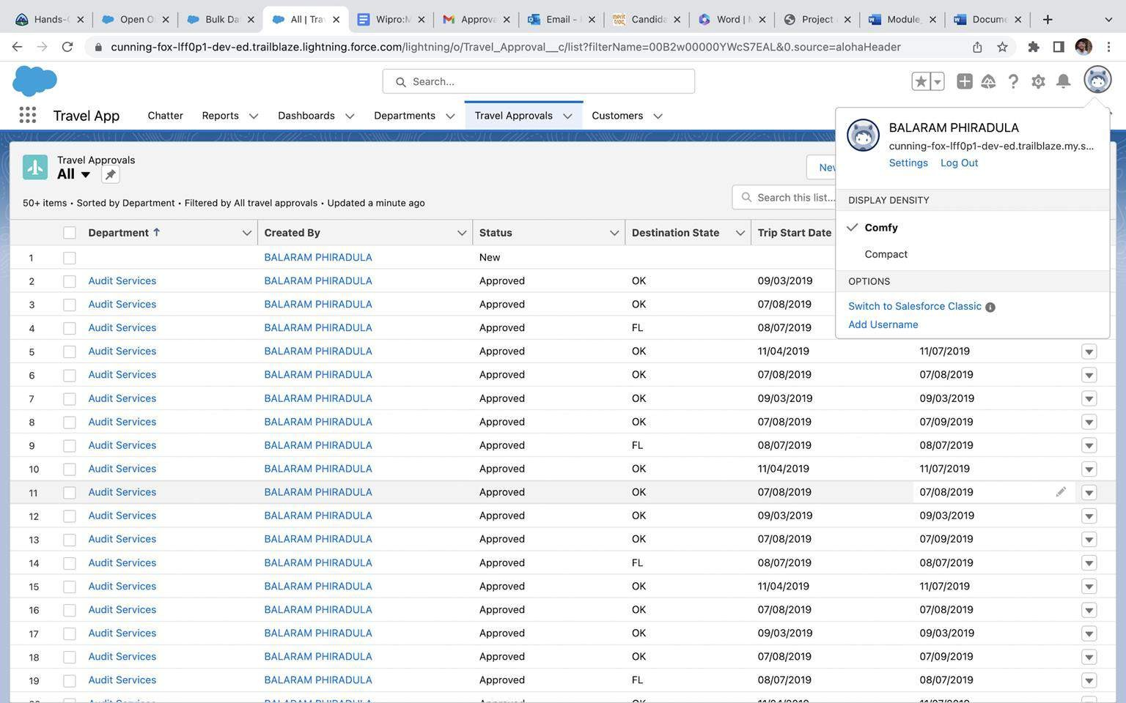
Using Data import wizard to import travel approval records , later the Records imported successfully

Slide 27
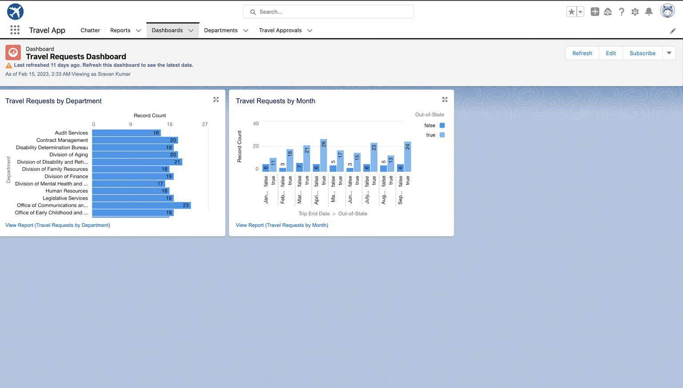
Final Dashboard

Slide 28
MODULE 3
This project module focuses on the coding approach to extend the
functional capabilities of your custom App.

Slide 29
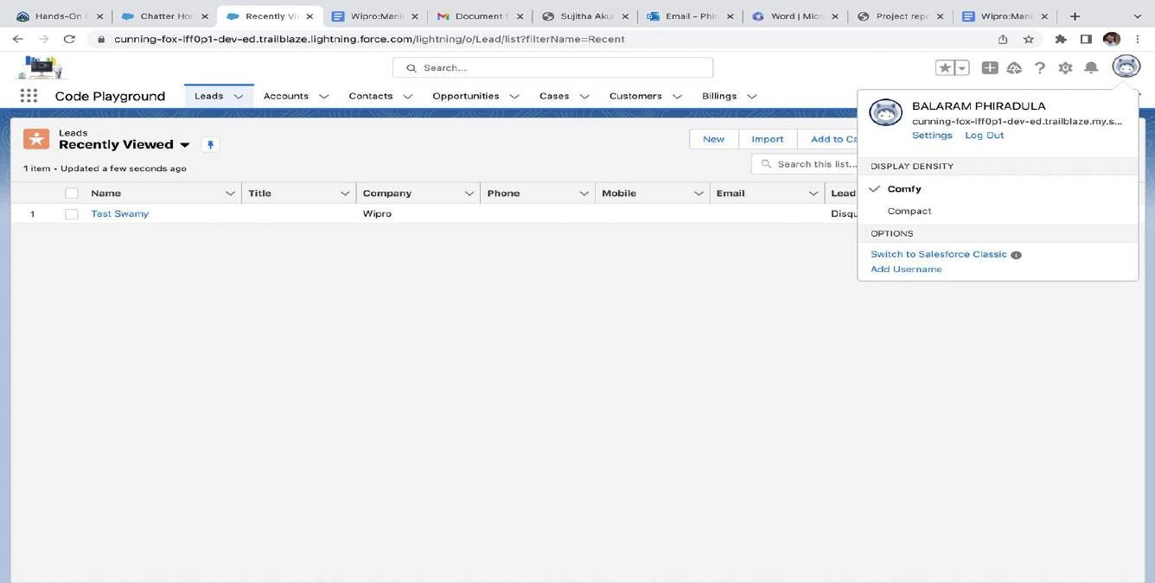
Exercise - 01
Creating Code Playground Lightning App with Lead, Account, Contact, Opportunity, Case to navigation profile as system admin.

Slide 30
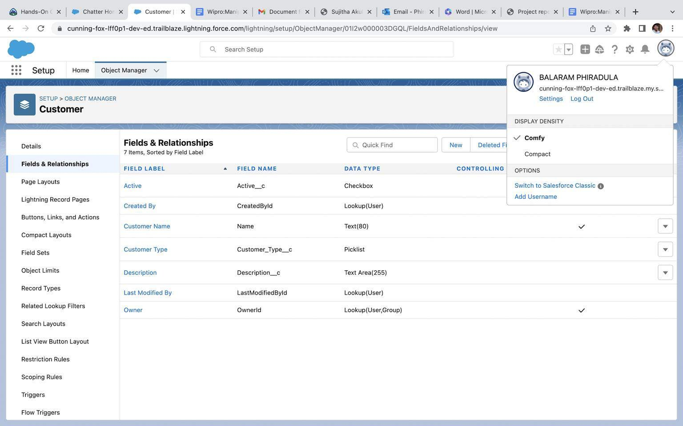
Creating custom object Customer and add related fields

Slide 31
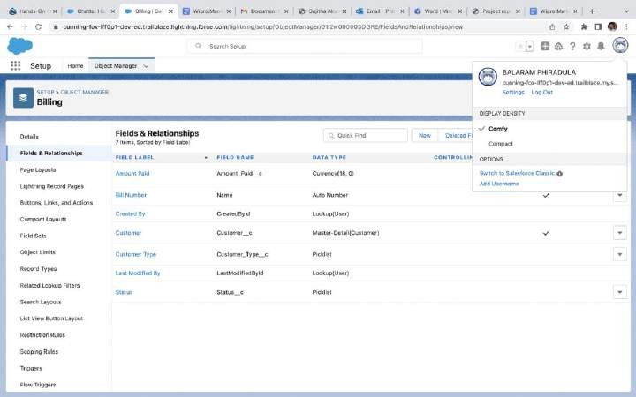
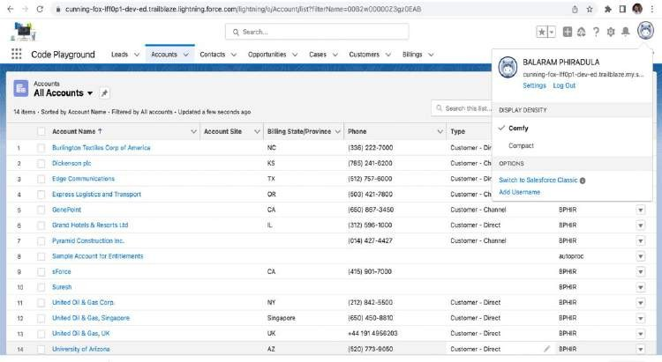
Creating custom object Billing and add related fields

Slide 32
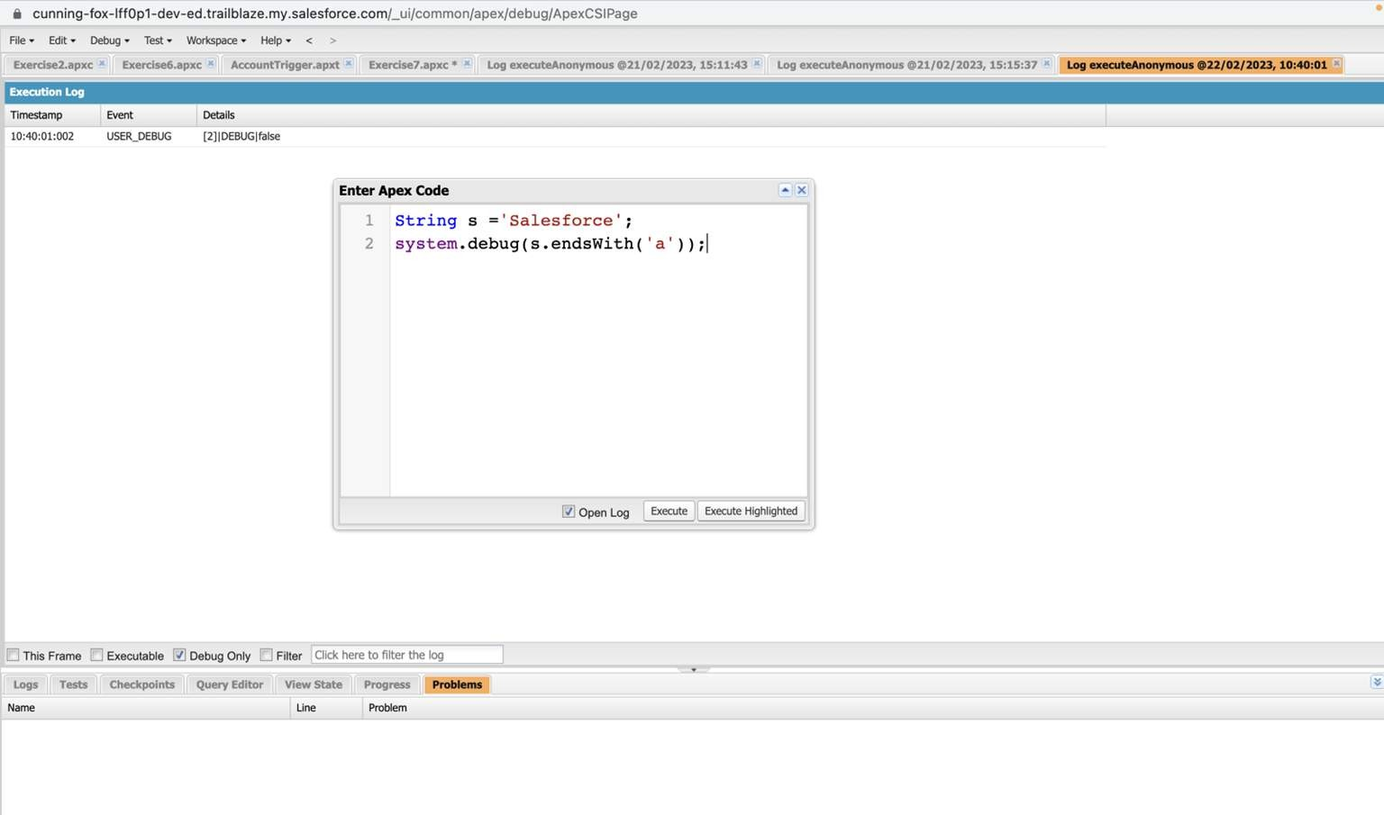
Exercise - 2
1.Define a String Variable & use string method ‘endsWith’ to display the output. By clicking oh Debug and select open Anonymous window

Slide 33
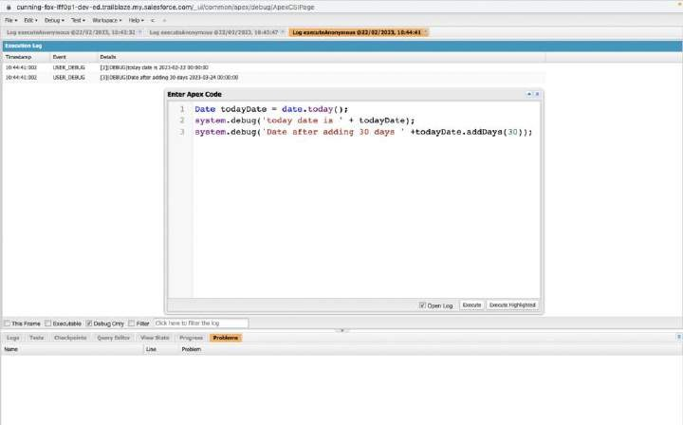
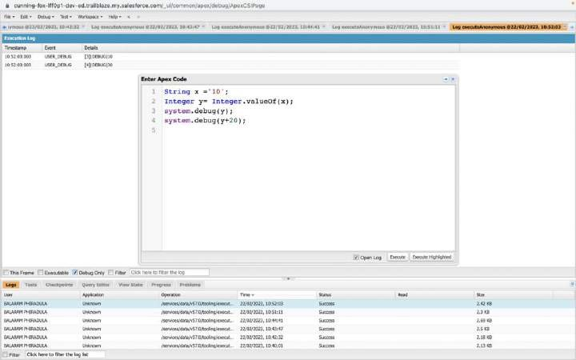
2. Define 2 Date type variables, use Date method today() & addDays(30) to display the output
3. Display the output of an Integer variable from string ‘10’ and then add 20 to it.

Slide 34
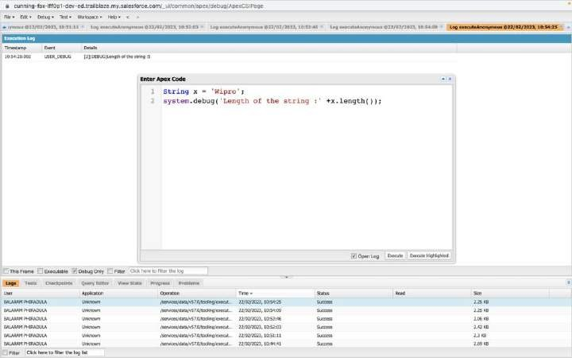
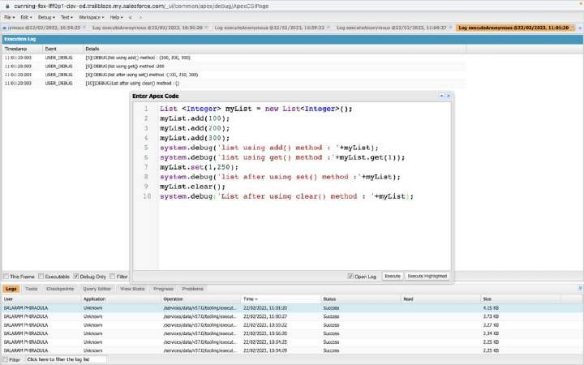
4. Define a String Variable & use string method length() to display the output
5. Define a List of integer and display the output using add(), get(), set(), clear(), methods.

Slide 35
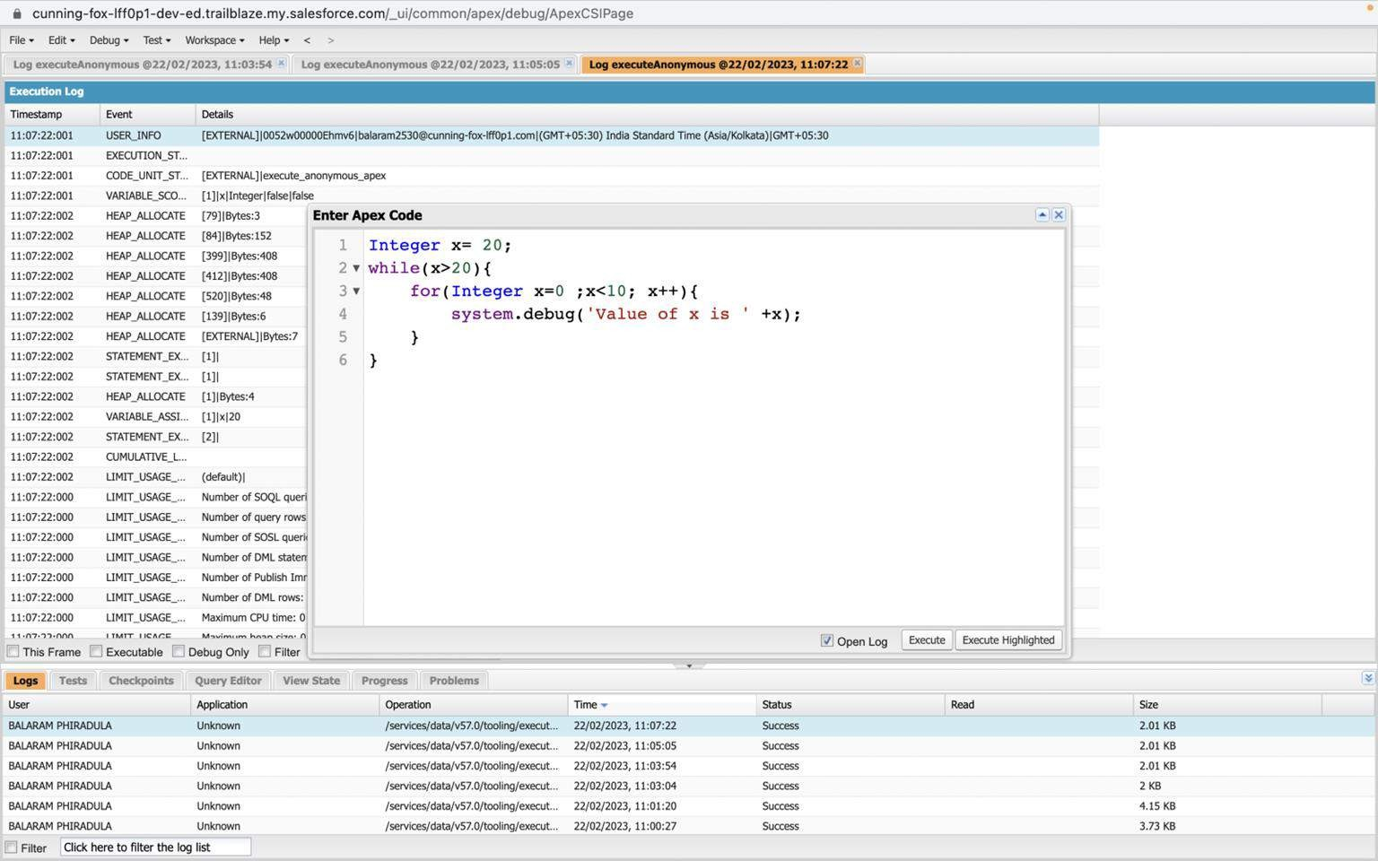
Use Execute Anonymous to define and execute the following code to display the value of x = 0 to 9.

Slide 36
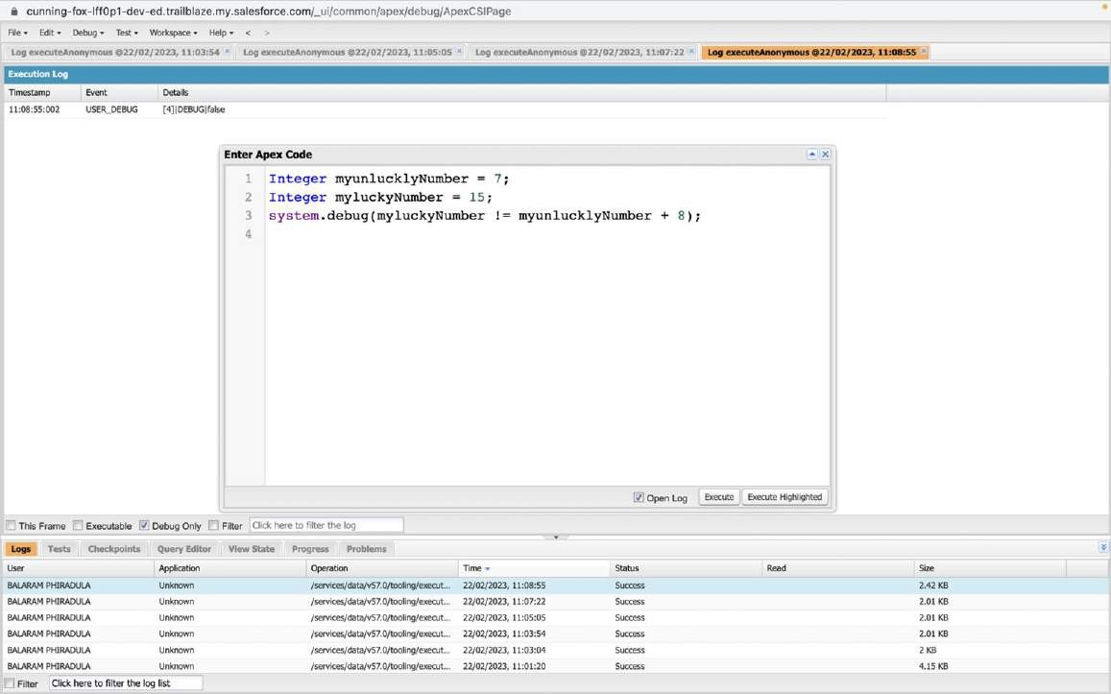
Exercise 3
Answer the following in True or False:
Integer myunlucklyNumber = 7; Integer myluckyNumber = 15;
myluckyNumber != myunlucklyNumber + 8.

Slide 37
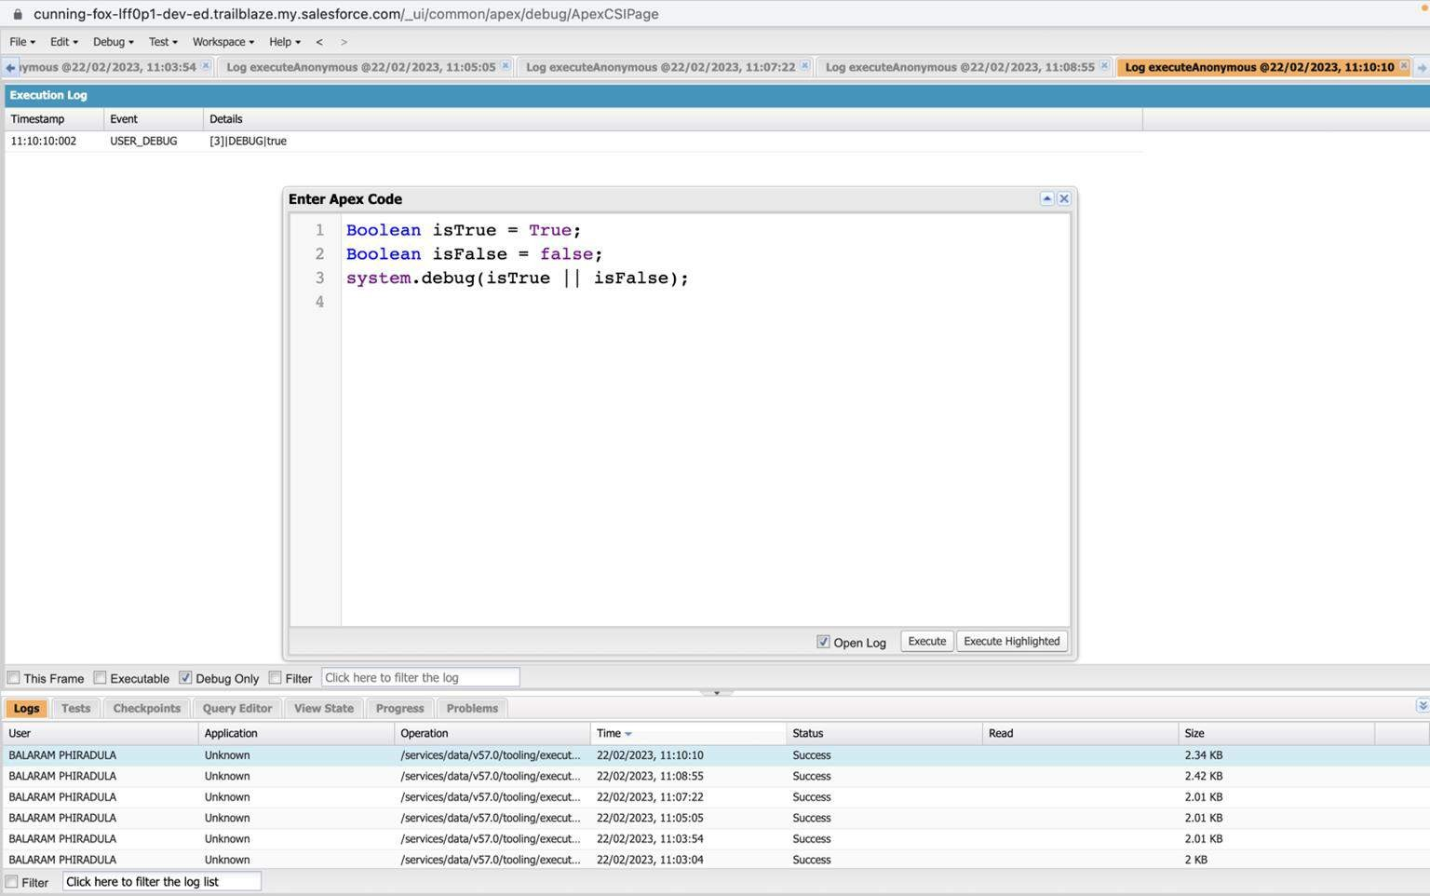
Exercise 4
Answer the following in True Or False: Boolean isFalse = false; Boolean isTrue = true;

Slide 38
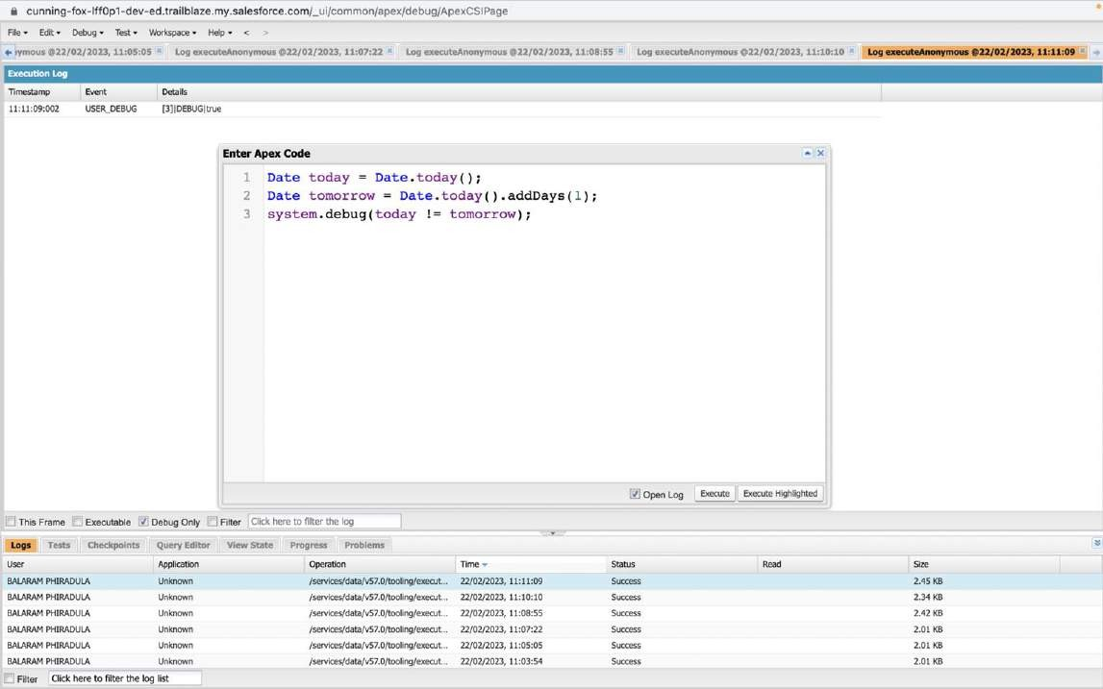
Exercise 5
Answer the following in True Or False: Date tomorrow = Date.today().addDays(1);
Date today = Date.today(); today != tomorrow

Slide 39
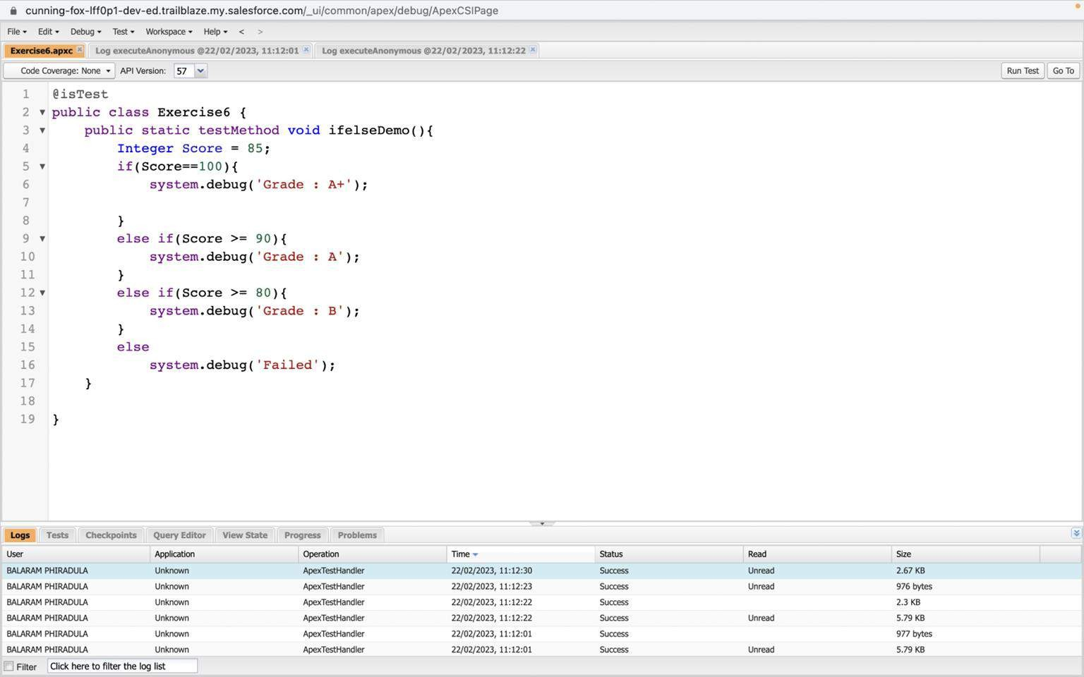
Exercise 6
Write a program and execute to demo the use of “If..else if...else”

Slide 40
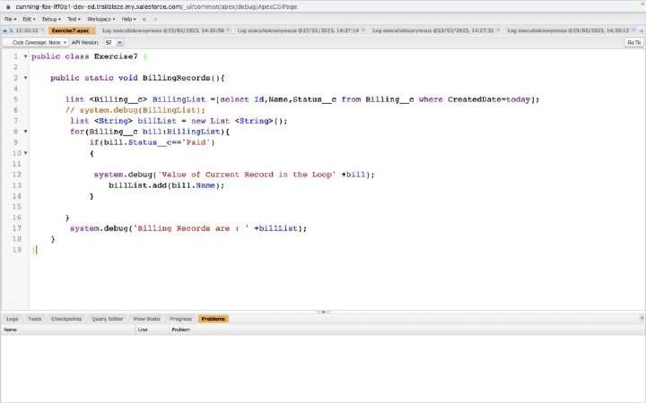
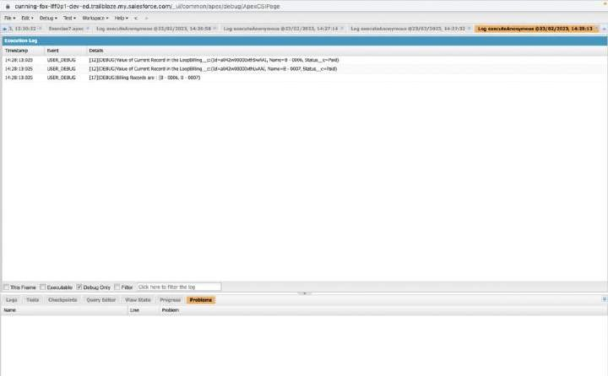
Exercise 7
Write a program to execute and demo the use of “Apex – for Loop”

Slide 41
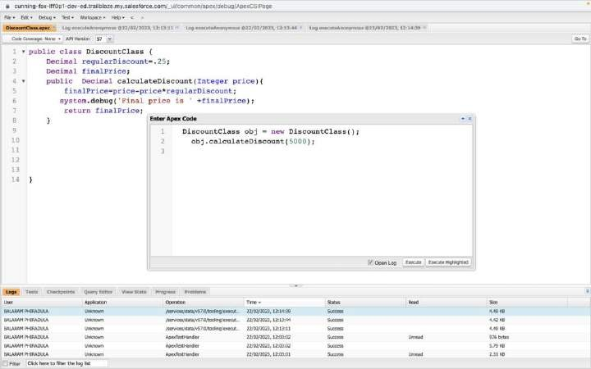
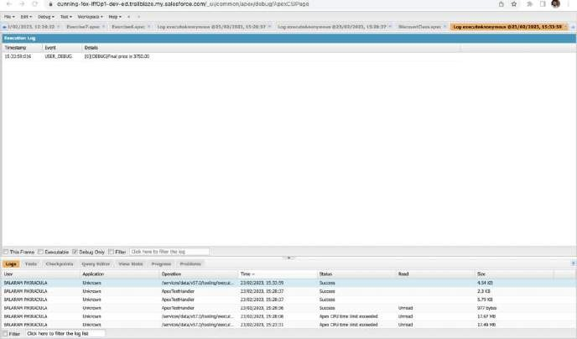
Exercise 8
Write a Class to demo the use of Constants in Apex

Slide 42
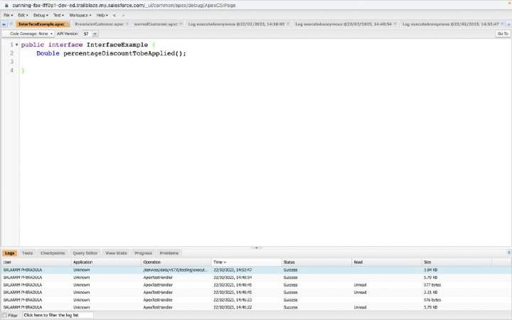
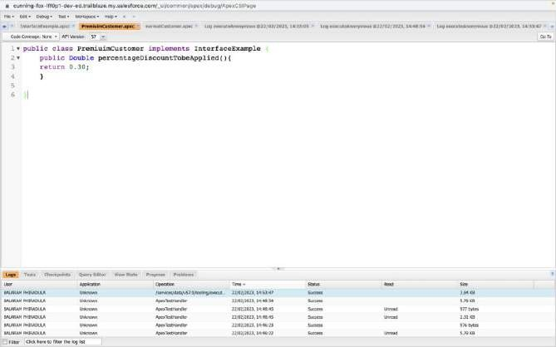
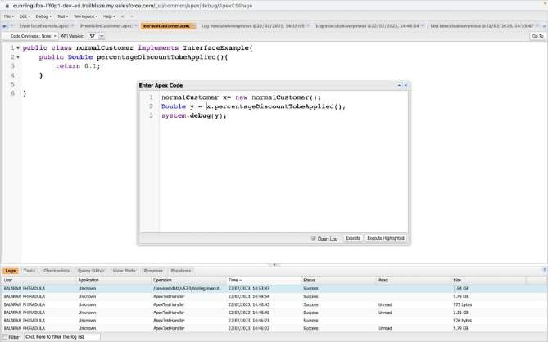
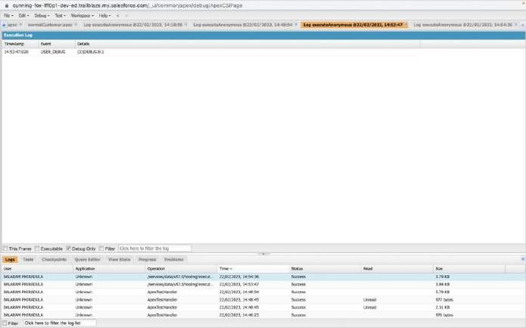
Exercise 9
Write a Class to demo the use of Interface in Apex

Slide 43
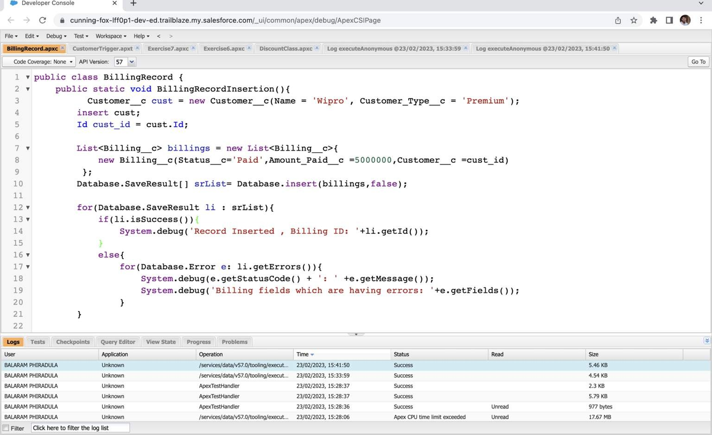
Exercise 10
Insert Billing record using Database methods Here use record id to insert customer

Slide 44
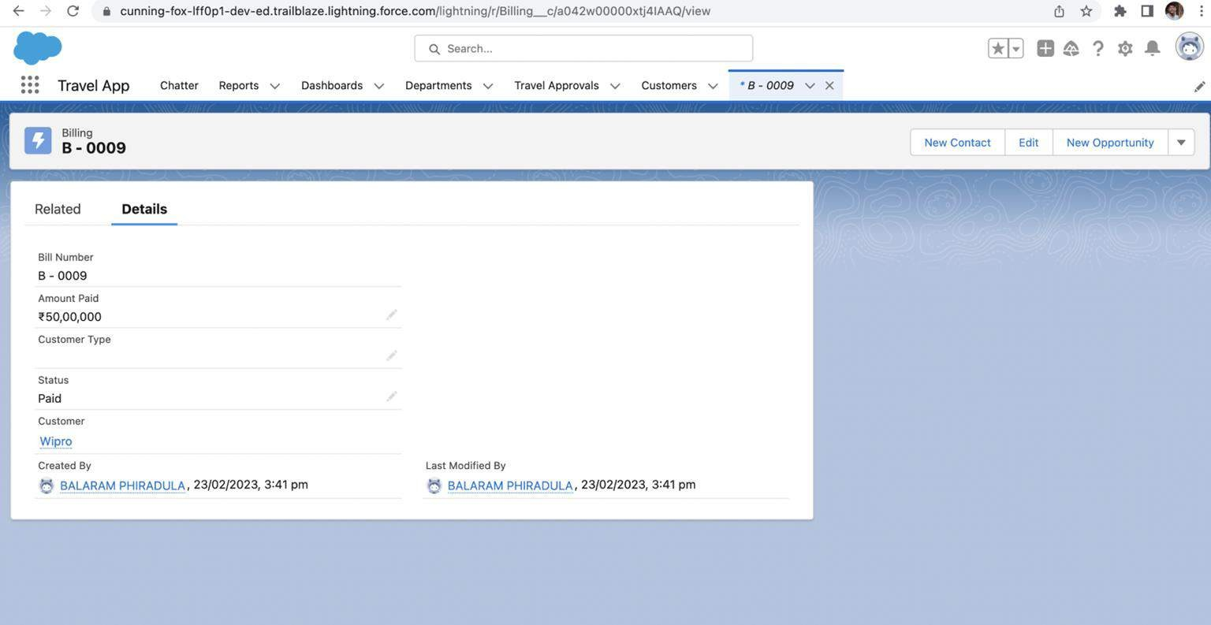

Slide 45

Write and execute SOQL queries from Developer Console Display ID, Amount, Stage, Account Name, Account Industry, Account
Website From Opportunity
AND “Account Annual Revenue > 5000”
Add a Where Clause “Account Industry = Energy”

Slide 46


Exercise 12
Write an Apex Trigger, Name = CustomerTrigger.
Create a Billing Record when on Customer Object the 'Status' field changes to Active from Inactive. Billing “Status” must be: Paid, Amount Paid = 15000
Perform the DML on a List.

Slide 47

Exercise 13
Write a Test Class for CustomerTrigger.
Create the Data for the Customer custom Object Use Test.startTest() & Test.stopTest().
Use assert statement to validate the output, Test Class must have full code coverage.

Slide 48

Exercise 14
ApexTrigger,Name=DisqualifyTestLeads

Slide 49


Exercise 15
Write a Test Class for DisqualifyTestLeads.

Slide 50


Exercise 16
Create a Visualforce page which displays Opportunity fields as output fields.

Slide 51


Exercise 18
Create a Visualforce page that uses a custom controller to display a list of cases with the status of 'New'. The page must be named NewCaseList.

